Slide 1

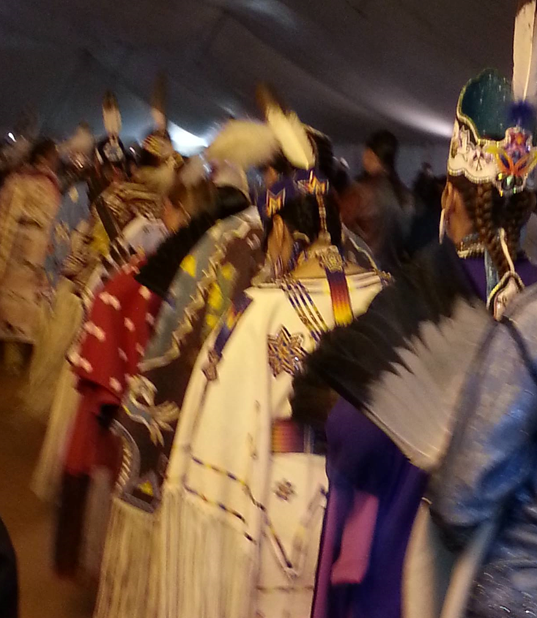
Indigenous History is Your History: Reconciling with Federal Indian Law
& Policy
University of Wisconsin – Madison
College of Agricultural & Life Sciences
Samantha C. Skenandore
Attorney/Of Counsel
Quarles & Brady LLP
April 19, 2021

Slide 2
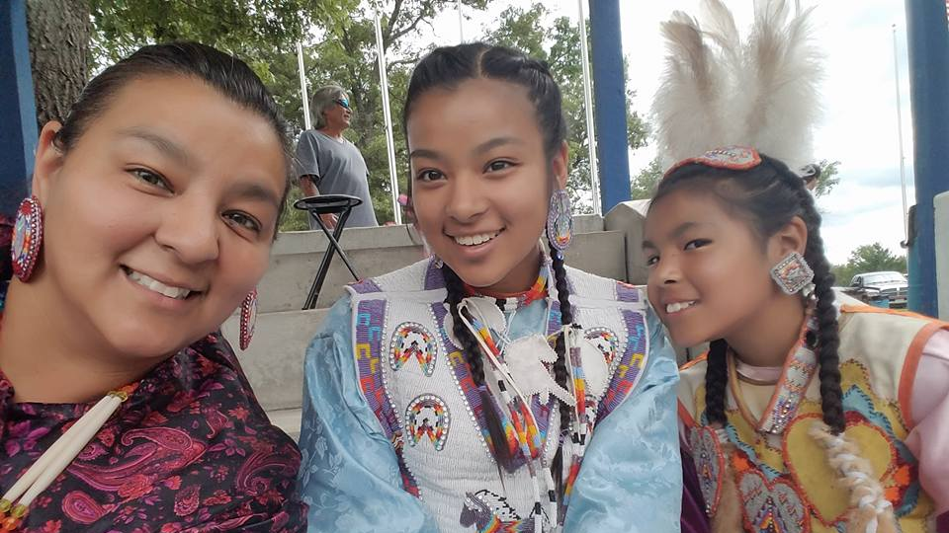
Anything you ever wanted to ask an indigenous person?

Slide 3
Overview
History of Federal Indian Law Policy
Key Principles
The Relationship of Tribes and the United States: Treaties, Tribal Sovereignty, the Federal Trust Responsibility & Federalism
Tribal Law & Government
Explicit & Implicit Culture: Cultural Awareness
Discovering Indigenous History as Your Own History

Slide 4
History of Federal Indian Law Policy
Pre-Constitution
(1492-1789)
Allotment and Assimilation (1871-1928)
Termination (1943-1961)
Formative
Years
(1789-1871)
Indian Reorganization (1928-1942)
Self-Determination
& Self-Governance (1961-present)

Slide 5
Key Principles
What is “Indian Country?”
What is an “Indian Tribe?”
What is Tribal Sovereignty?
Canons of Construction
Federalism & Anti-Federalism

Slide 6
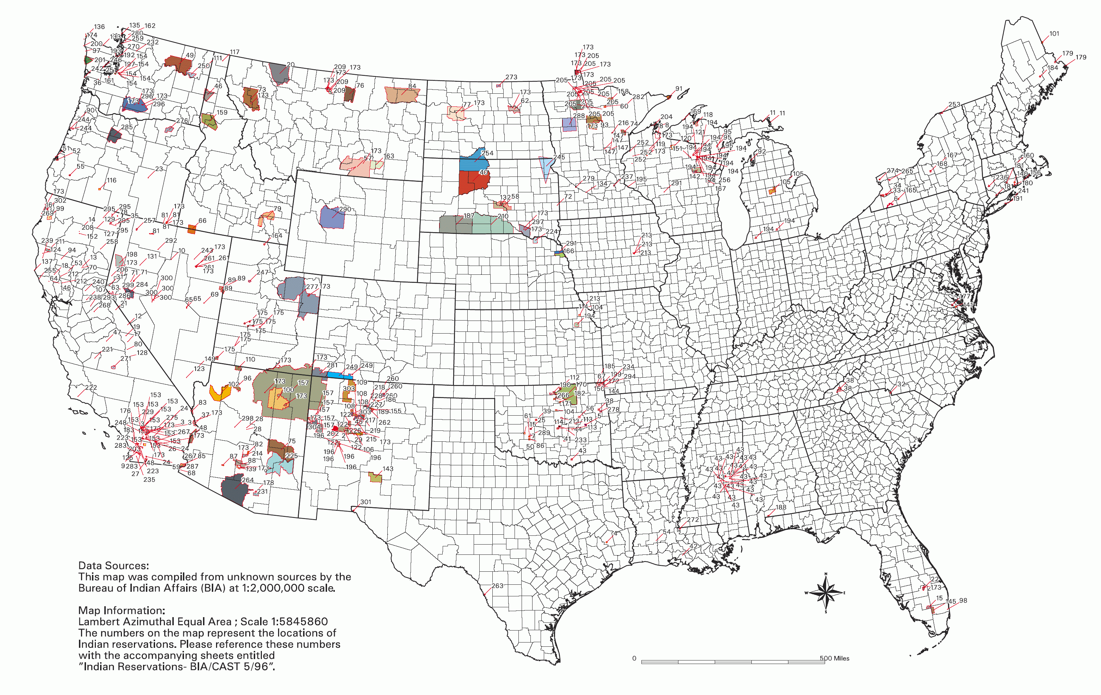
Overview of Indian Land = Indian Country
All lands within the limits of any Indian reservation, including rights-of-way running through the reservation
All dependent Indian communities within the U.S.
All Indian allotments

Slide 7

Indian Tribe
The U.S. Supreme Court has classified Indian tribes as:
  “domestic dependent nations”
  “distinct, independent political communities”
The are 573 federally recognized Indian tribes in the U.S.
There are 11 federally recognized tribes in Wisconsin. Note that the Fon du Lac Band of Lake Superior Chippewa (Minnesota) owns trust land and possesses treaty rights within Wisconsin.

Slide 8
Treaties
Between federal government and Indian tribes
  Treaty Clause, U.S. Const. art. II, § 2, cl. 2
  Executive authority with Senate consent
  Commerce Clause, U.S. Const. art. I, § 8, cl. 3 “regulate Commerce with…the Indian Tribes.”
  Not a grant to tribes, but a cession and reservation by the tribes
  Congressional responsibility to carry out
Abrogation

Slide 9
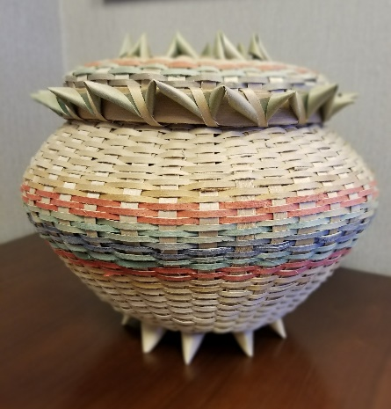
Tribal Sovereignty
Inherent powers of self-government, by reason of their
original tribal sovereignty, not by virtue of any delegation
of powers.
  Membership
  Form of tribal government
  Govern members and territories
  Administer justice
  Power to exclude
“Indian tribes still possess those aspects of sovereignty not withdrawn by treaty or statute, or by implication as a necessary result of their dependent status.” U.S. v. Wheeler, 435 U.S. 313, 323 (1978).

Slide 10
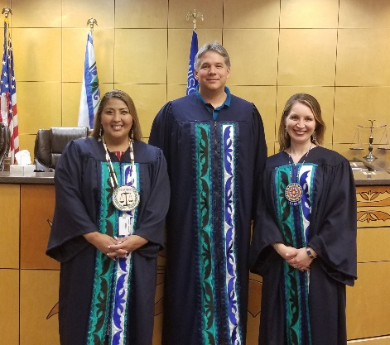
Tribal Sovereignty
A tribe retains its sovereignty until Congress acts to divest that sovereignty.
Limitations may arise through treaties and statutes – clear and unambiguous
Limitations on conveyances of tribal property
  General Allotment Act
  Major Crimes Act
  Indian Civil Rights Act
  PL 280 (includes Wisconsin)

Slide 11
Federal Trust Responsibility
Federal government’s unique relationship with Indian tribes
  Evolved from treaties, statutes, and courts
  Reaffirmed through legislation, invoked through administrative action, court decisions
Scope
Enforcement
  Breach of trust claims (see: https://en.wikipedia.org/wiki/Cobell_v._Salazar)
  Administrative Procedures Act

Slide 12
Federalism & Anti-Federalism
Federalism: application of federal law
Anti-Federalism: application of state/local law
The Supremacy Clause

Slide 13
U.S./Tribal Relationship Take Aways
Tribes have a special political government-to-government relationship with the federal government
The federal government "has charged itself with moral obligations of the highest responsibility and trust" toward Indian tribes (Seminole Nation v. United States, 1942)
Tribes exercise sovereignty pursuant to statutory affirmations, restrictions and court precedent within their jurisdictions
States generally have no jurisdiction in tribal jurisdictions
Federal Indian law establishes special restrictions and rights to tribes

Slide 14
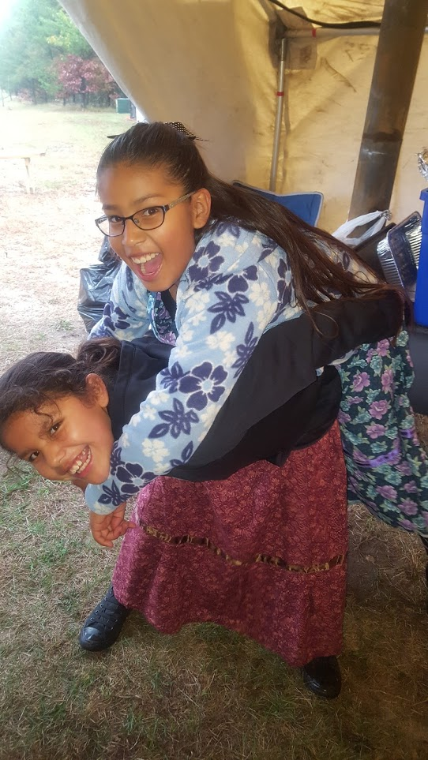
Defining
Culture
Cultural awareness
Cultural competency
Cultural sensitivity
Ways we group other people
Explicit culture
Implicit culture

Slide 15
What is cultural awareness?
A mindset that cultural diversity exists
What is cultural competency?
Knowledge of the frameworks of a culture
What is cultural sensitivity?
To reconcile conflicting values and behaviors judgement free; the ability to empathize with cultural differences
RECOGNIZE/ACKNOWLEDGE
EDUCATE
PRACTICE

Slide 16


How do we group people together?

Slide 17

Explicit culture vs. Implicit culture
The cultural iceberg experiment

Slide 18
Defining explicit and implicit culture
Explicit culture – another person’s culture that is obvious or intentional, or expressed
Implicit culture – another person’s culture that is not obvious or not otherwise displayed

Slide 19
Uniqueness of each Tribe
Language
Religion
Customs
Government
Political status
Structure
Membership
Resources

Slide 20
Tribal government structure
Political status
Federally-recognized?
Tribe from another state?
Termination act or federal recognition act?
Structure
Indian Reorganization Act “cookie-cutter” constitutional forms
Traditional government based on traditional culture, such as clans
Modern democracies – special “4th” branch of government representing the people
Native Corporations where tribal members are “shareholders”
Membership
Resources

Slide 21
Authorities underpinning the modern government-to-government relationship between tribes and foreign governments – the body of federal Indian law
Treaties
The United States Constitution
Case law

Slide 22
Discovering Indigenous History as Your History
Start with the basics. Where do you come from?
What indigenous peoples call that same place home?
What is your explicit and implicit biases towards that particular community? What has shaped those biases?
What can be learned?
What resources are available?
What considerations should you observe?

Slide 23
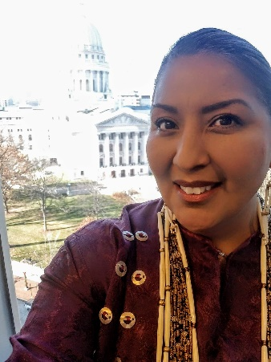
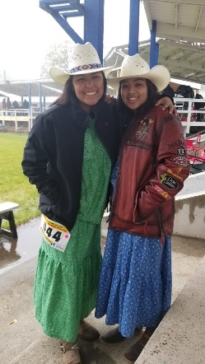
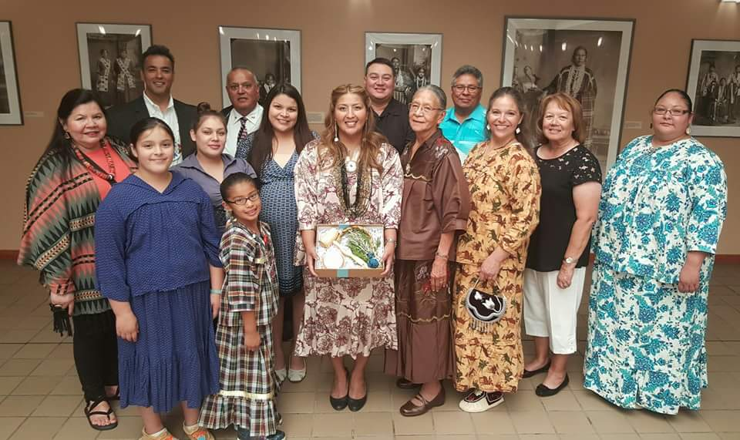
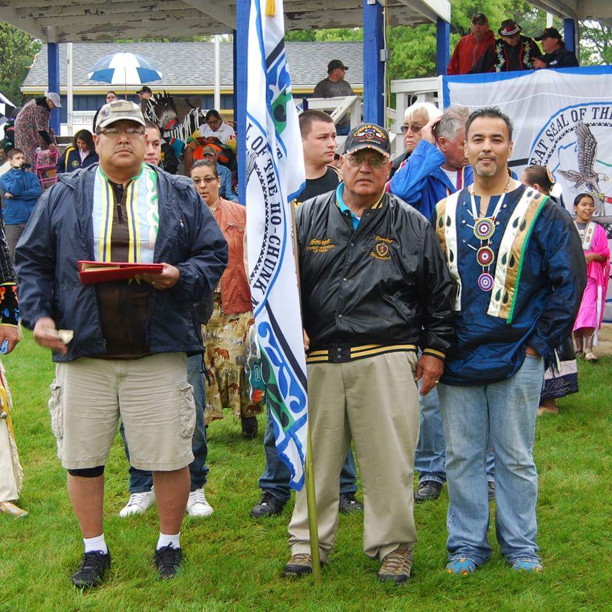
My family, my group

Slide 24
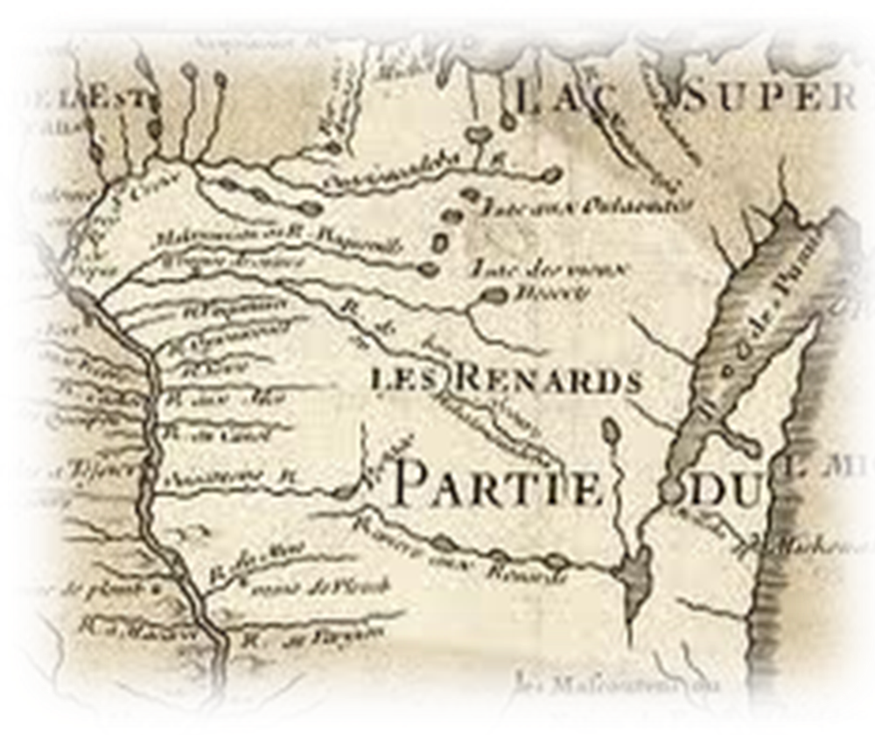
Colonial Culture & Impacts to Indigenous People
Doctrine of Discovery
Manifest Destiny
Cultural Genocide
Cultural Appropriation/
Misappropriation
Termination
Environmental Genocide

Slide 25

The value of cultural property
The value of cultural property is immeasurable
Cultural property is the fabric that is the foundation of indigenous people's origin, identity, and history
The importance of indigenous cultural property makes them targets of exploitation, theft, and irreversible harm
Indigenous cultural property is inherently rare and must sustain its integrity in poor weather condition, absent or negligent caretaking, and other environmental actions
Authentic indigenous cultural property cannot be reproduced
Indigenous cultural property is therefore at risk for loss or irreversible harm.

Slide 26
TeeJop Sites (non-exhaustive list)
Picnic Point Mound
Hudson Mound Group
Vilas Park Mound Group
Observatory Hill Mound Group
Bear Mound Park

Slide 27

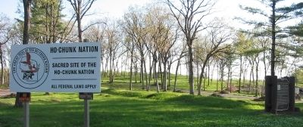
Other Sacred Places
Man Mound
Kingsley Bend Mound, Wisconsin Dells, WI
Martha's Vineyard, Aquinnah, Massachusetts & Nantucket Sound

Slide 28
Discovering Tribal Culture
Tribal website. Each tribe has an immense history, seemingly infinite and still practice intergenerational knowledge through oral history
  Pay attention to the tribe's use of language, religious practices and culture
Indian Studies classes
Events on campus or at the state capital (Wisconsin State of the Tribe)
National Congress of American Indians: www.ncai.org
Wisconsin Historical Society: https://www.wisconsinhistory.org/

Slide 29
Discovering Tribal Culture (cont.)
  Indian Mounds of Wisconsin by Robert A. Birmingham and Amy L. Rosebrough
  Spirits of Earth: The Effigy Mound Landscape of Madison and the Four Lakes by Robert A. Birmingham
  Aztalan: Mysteries of an Ancient Indian Town by Robert A. Birmingham

Slide 30
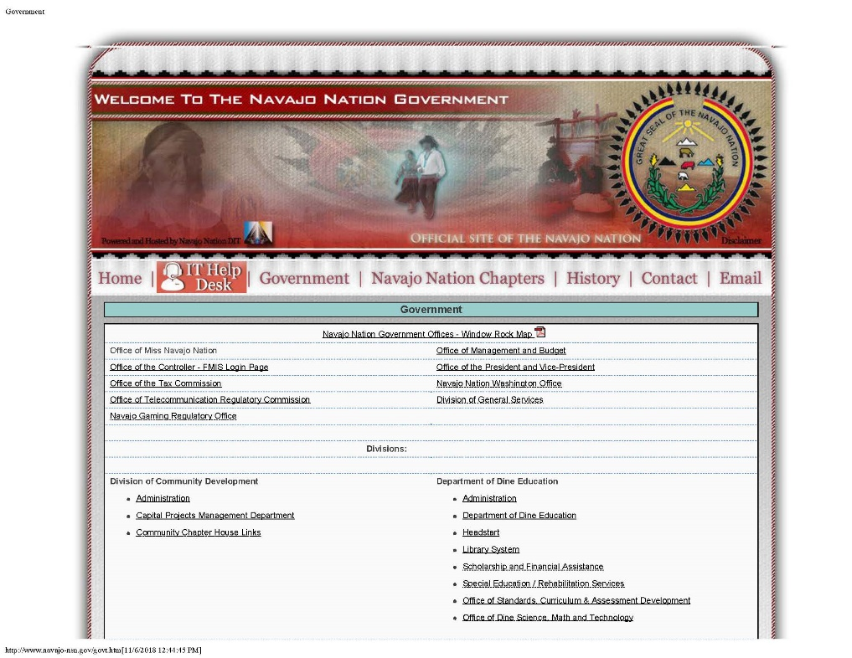
Tribal Website Example
Available at: http://www.navajo-nsn.gov/govt.htm

Slide 31
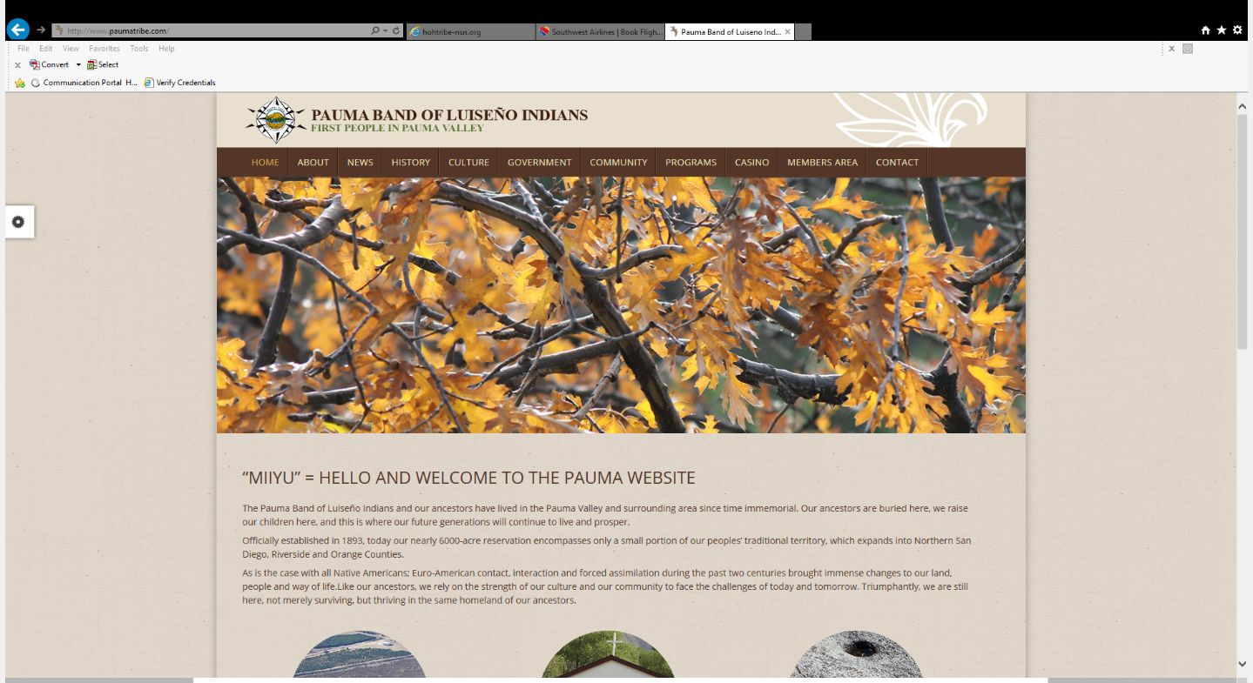
Tribal Website Example
Available at: http://www.paumatribe.com/

Slide 32
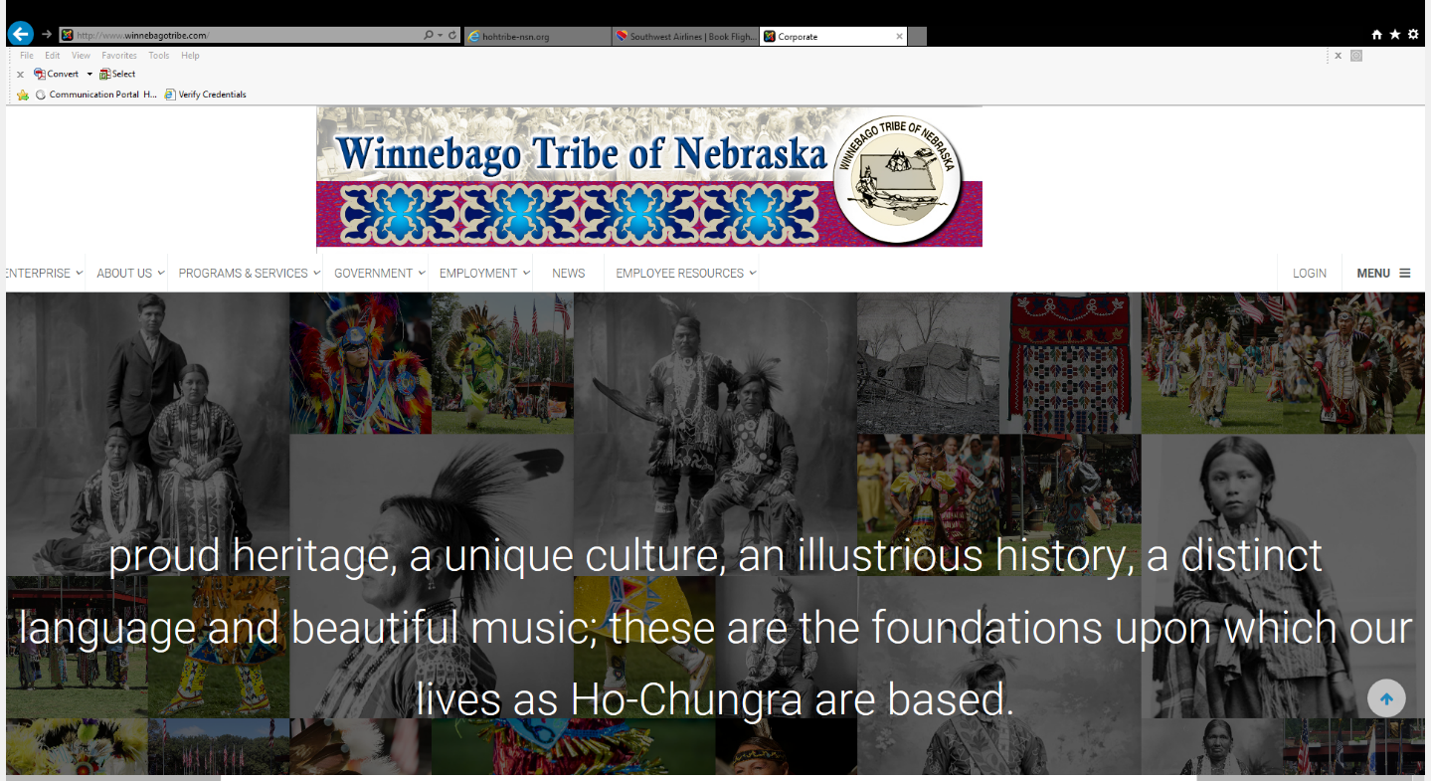
Tribal Website Example
Available at: http://www.winnebagotribe.com/

Slide 33
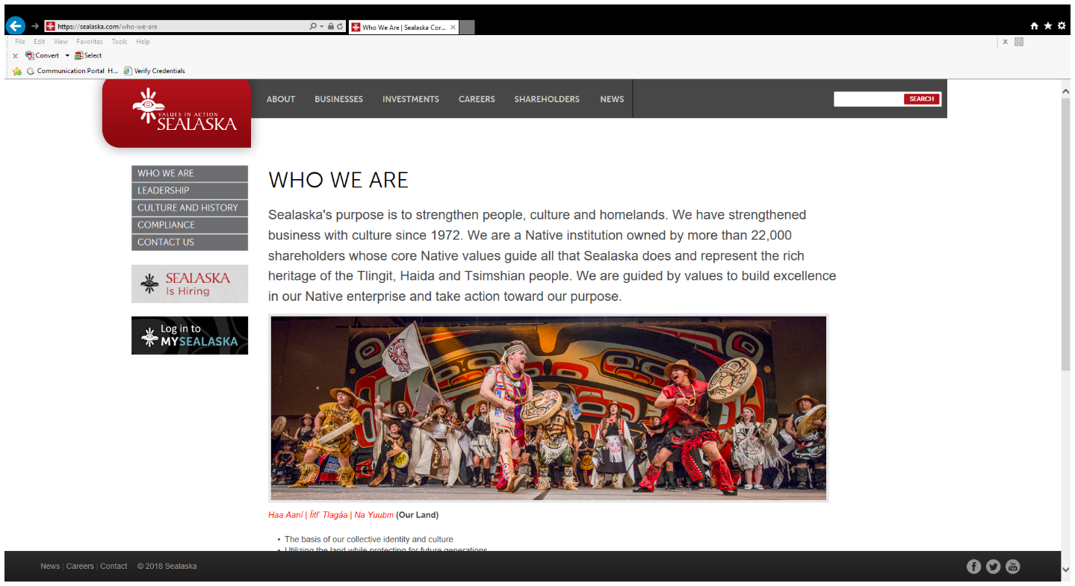
Tribal Website Example
https://sealaska.com/who-we-are

Slide 34
How do you see Indigenous history as your history?

Slide 35

Questions?
Samantha C. Skenandore
Attorney/Of Counsel
Quarles & Brady LLP
33 E. Main St., Suite 900
Madison, WI 53703
Direct 608.283.2459
Cell 608.630.1083
Samantha.Skenandore@quarles.com

